Slide 1

Deep Reinforcement Learning for Simulated Self Driving Car
Presented By: Gunjan Khut
ENMP 808F – Robot Learning

Slide 2
Motivation
The tasks involved in creating a self driving agent can be divided into 3 categories :
• Recognition : Identifying components of the surrounding environment.
• Prediction : Building internal models that predict the future states of the environment.
• Planning : Recognition and prediction to plan the future sequence of driving actions.
Reinforcement learning can be used in planning part.
Deep Reinforcement learning is one of the most promising approach for human level control.

Slide 3
Introduction
The project uses a car model developed in Graphical interface which enables it to travel from one point to other in a rectangular map using Deep Q learning.
It also displays collision avoidance while moving in the simulation environment.
Deep Q-Learning is the result of combining Q-Learning with an Artificial Neural Network.
In DQN
The states of the environment are encoded by a vector which is passed as input into the Neural Network.
Then the NN tries to predict which action should be played, by returning an output Q-value for each of the possible actions.
Eventually, the best action to play is chosen by overlaying a SoftMax function.
Used Experience replay to avoid the correlation problem.

Slide 4
Approach
Development of Graphical interface with a car and sensors in a rectangular map.
Used Reinforcement learning to teach the car through interaction with environment.
Formalized RL problem in Markov Decision Process.
Q-learning algorithms to solve Markov Decision Process problem.
Deep Q learning
Experience Replay to avoid correlation problem.

Slide 5
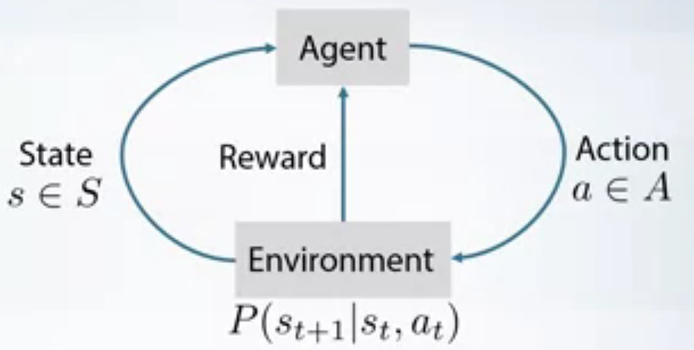
Key Concept's
Reinforcement Learning :
Reinforcement Learning is a part of Machine Learning which mainly focuses on making models which learn from mistakes so as to maximize the rewards.
Environment -> Try and Fail -> Eventually Learn-> Reach Goal.
Markov Decision Process
Markov decision processes (MDPs) provides a mathematical framework for model decision making in situations where the outcomes are partly random and partly under the control of a decision maker.
A Markov Decision Process is a tuple (S ; A ; T; R)
where:
S - set of the different states
A - set of the different actions that can be played at each time t
T - Transition rule
R - Reward function
Image from https://www.coursera.org/lecture/practical-rl/markov-decision-process-d9I1E

Slide 6
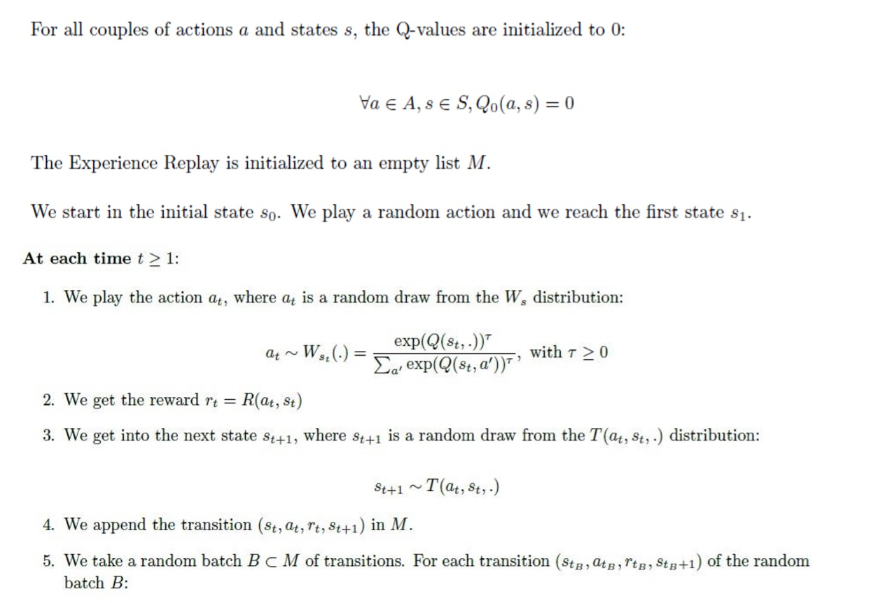
Learning Process

Slide 7
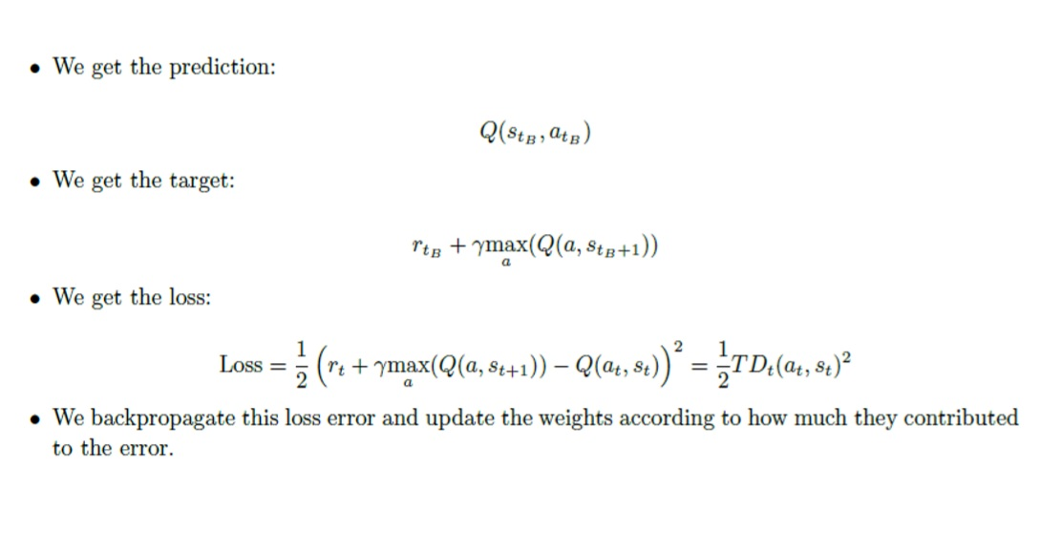
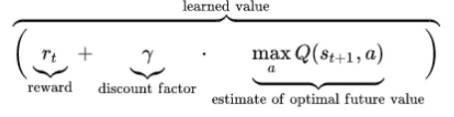
Learning Process continued

Slide 8
Simulation Environment & Tools Used
The Car model and sensor is build in Kivy and then imported in python program to add the attributes.
Obstacles created using Python with an array that has as many cells similar as the graphic interface has pixels.
Each cell has
1 – if obstacle present
0 otherwise.
The values are updated 0.016 per seconds in the simulation environment. (60fps)
Load button on screen can be used to load the last saved trained network.
Tools:
Programming language : Python
Libraries : Kivy , NumPy , Torch

Slide 9
Deep Q Network
Q Learning
Number of states : 5
Signal from Front Sensor,
Signal from Left Sensor,
Signal from Right Sensor,
Orientation of the car with respect to the goal,
Negative of the Orientation of the car with respect to the goal.
Number of actions : 3 ( Move Left, Move Right , Move straight)
Discount Factor : 0.9
Rewards :
-1 ( When in contact with obstacle)
-0.2 ( When car moves away from the direction of the goal )
-1 ( When car is near any of the four edges)
0.1 ( When car is moving closer to the goal )

Slide 10
Deep Q Network
Artificial Neural Network
Number of Hidden Layer : 1
Number of Input neuron : 5
Number of output neuron : 3
Number of neuron in hidden layer : 30
Forward Activation function : Rectifier
Optimization function : Adam
Initial learning rate : 0.001
Replay Memory Size : 100,000 Transition.
The neural network predict Q values which are then compared with target Q value to get the error, which is then used to update weights from back propagation.

Slide 11
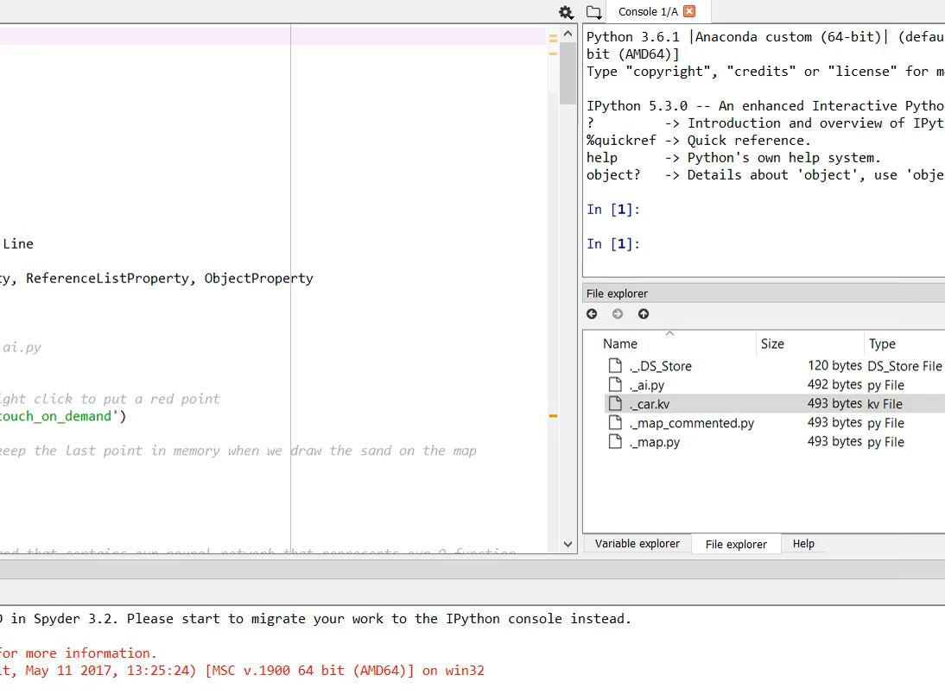
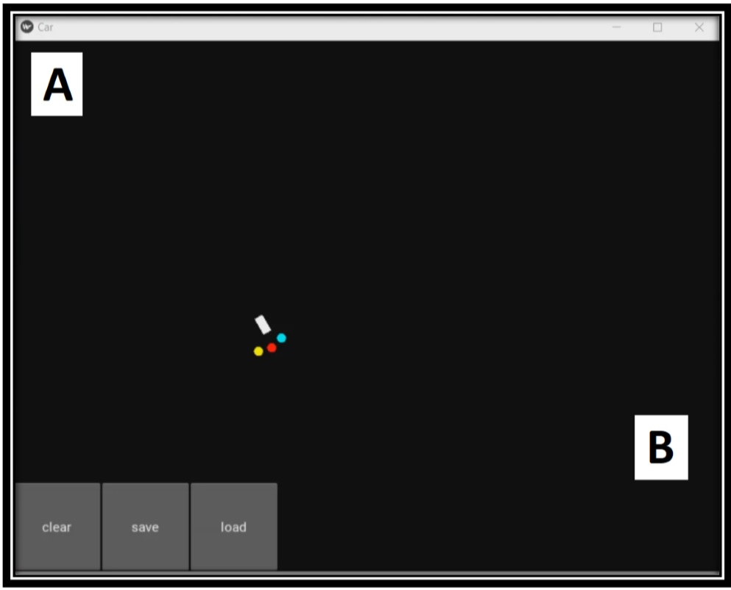
Task 1 : Movement from A to B

Slide 12
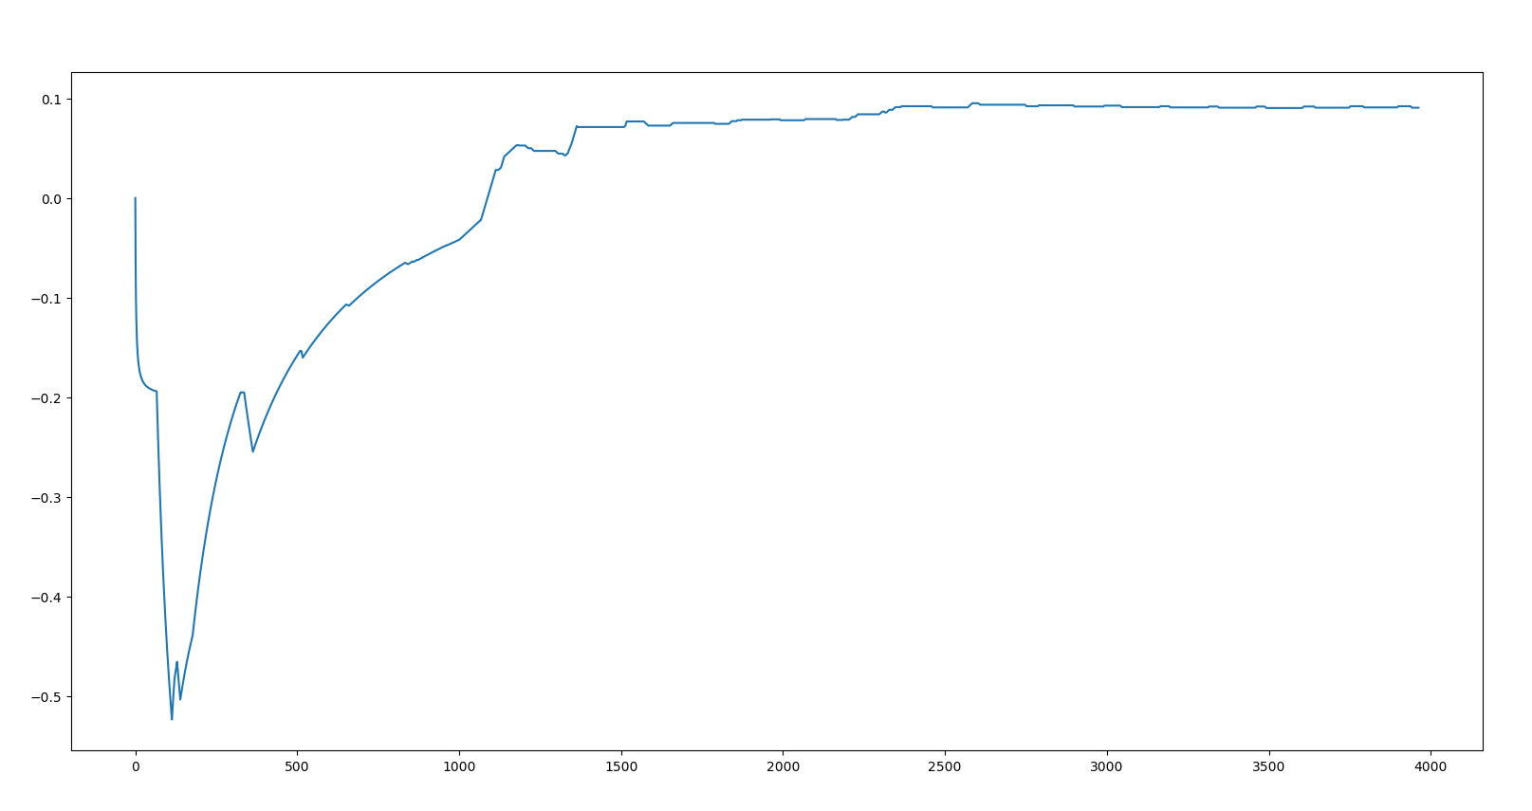
Result : Task 1
Reward vs Time Plot ( Task 1)
Maximum reward achieved at 4,000 simulation runs.

Slide 13
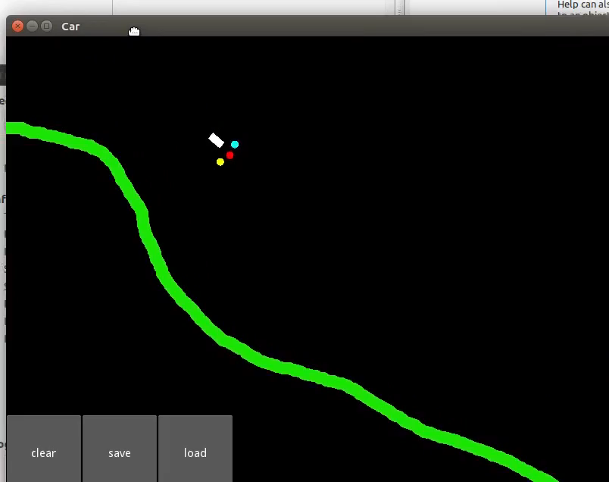
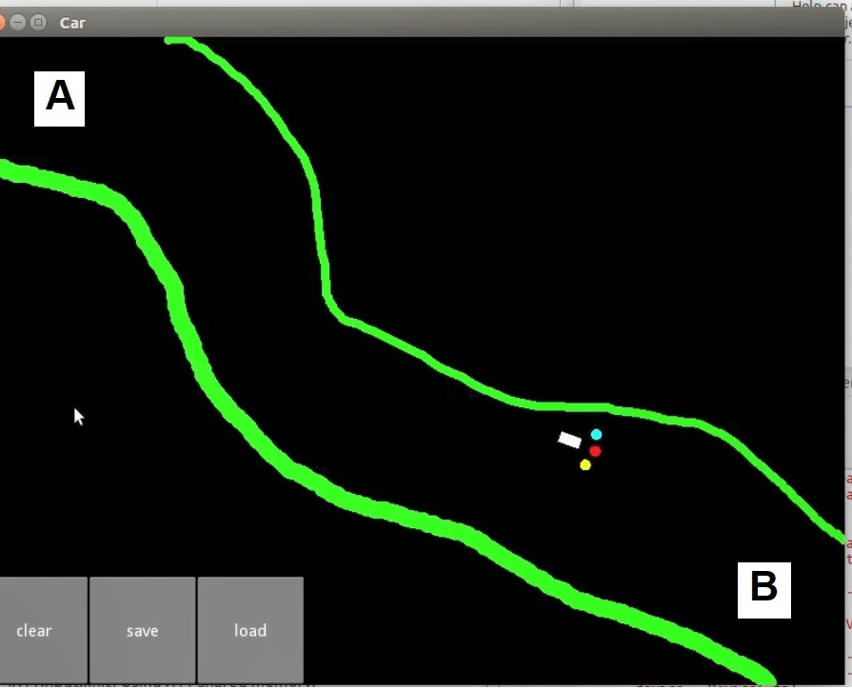
Task 2 : Movement confined in a Road while going from A to B

Slide 14
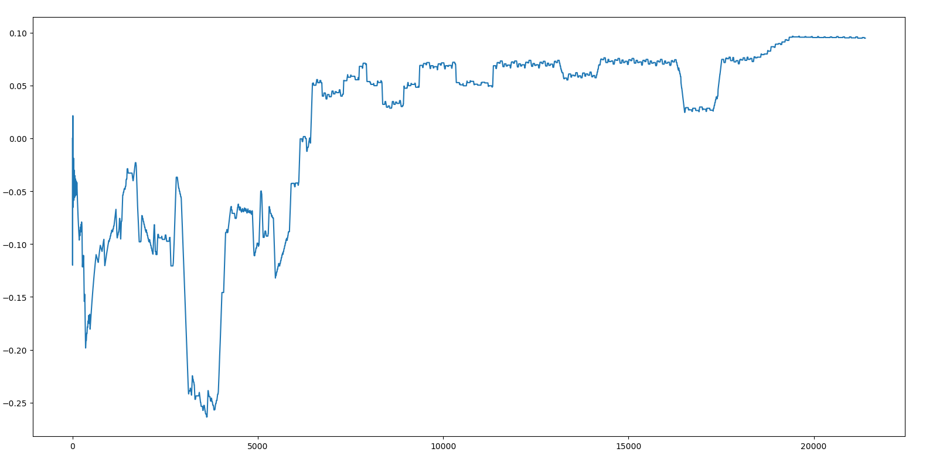
Result : Task 2
Reward vs Time Plot ( Task 2)
Maximum reward achieved at 20,000 simulation runs.

Slide 15
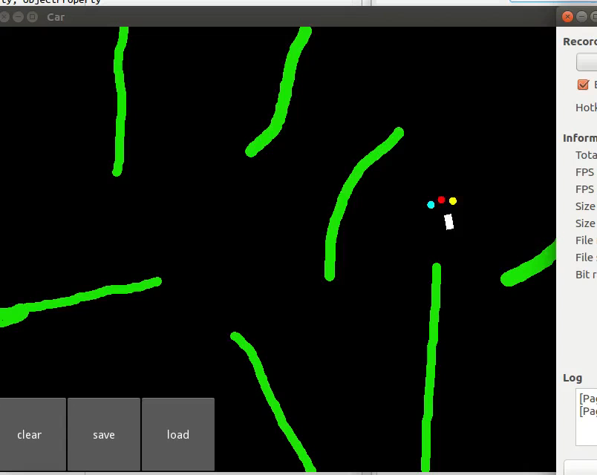
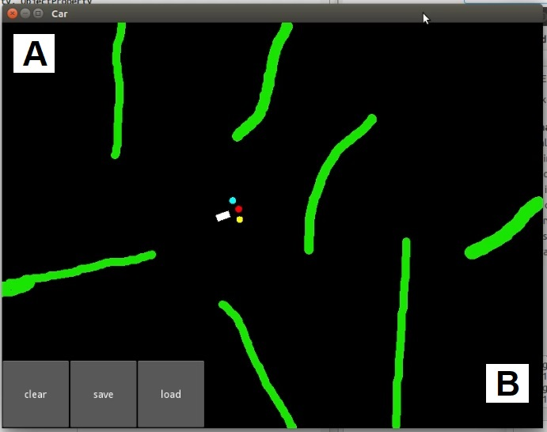
Task 3 : Collison avoidance while going from A to B

Slide 16
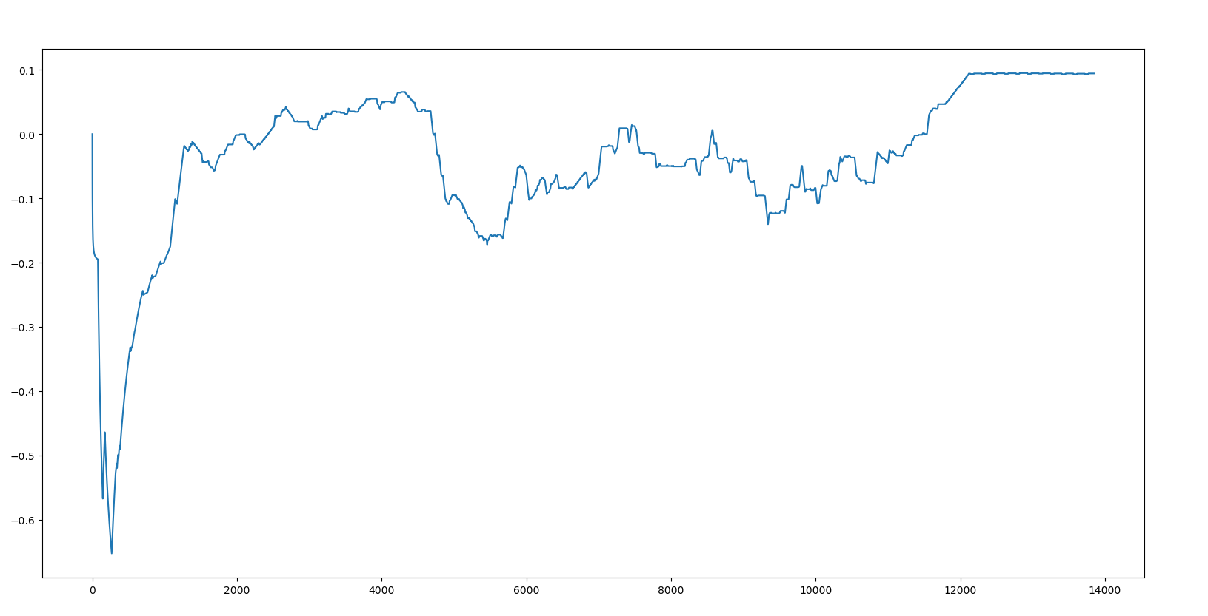
Result : Task 3
Reward vs Time Plot ( Task 3)
Maximum reward achieved at 13,000 simulation runs.

Slide 17
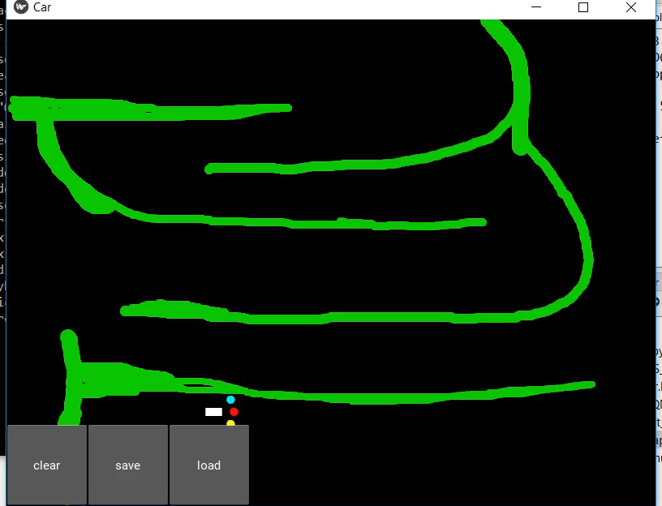
Challenges and Future Work ….
Though car performed very well in all three task , but when map was made more complex , it did not achieved the maximum rewards.

Slide 18
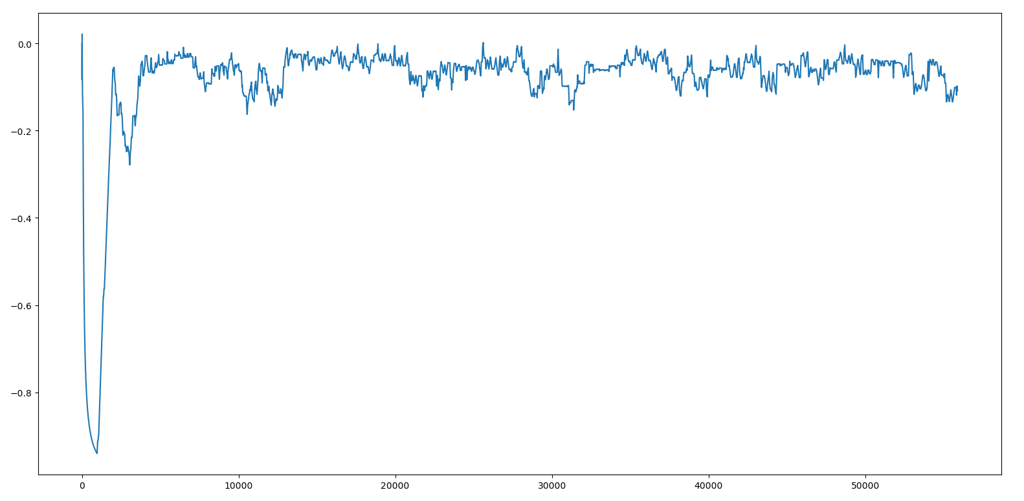
Future Work
Reward vs Time Plot
More Hidden layers.
Addition of states ( May be time constraint using timer )
Change in rewards

Slide 19
References
https://www.intel.ai/demystifying-deep-reinforcement-learning/
https://kivy.org/doc/stable/tutorials/pong.html
https://www.udemy.com/artificial-intelligence-az/
Link to this project
https://github.com/gkkhut/Deep-Reinforcement-Learning-for-Simulated-Self-Driving-Car

Slide 20
Thank You

